Slide 1
Protocol Stack
Jinfei

Slide 2
1,MTK在ALPS上有自己的主基线，在维护。
给不同客户，拉满足客户需求的客户基线，并维护。
2,一个系统:CQ系统，两个database: MAUI,ALPS
客户提的case叫eservice,内部的叫CR,都在同一个database中
最终解决issue的CR,会有check in source code，就是PATCH ID.
在每一个eservice ID上可以clone另一个CR给BM并注明PATCH ID,这就是REQUEST
3, log & debug tools
SD Card logging :MTKLogger
tool logging:GAT android log & kernel log, Cather/ELT Modem log
QAAT , AEE

Slide 3
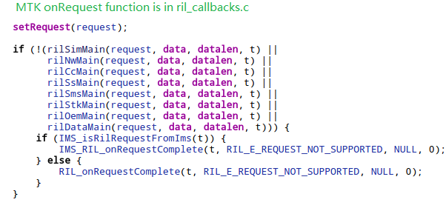
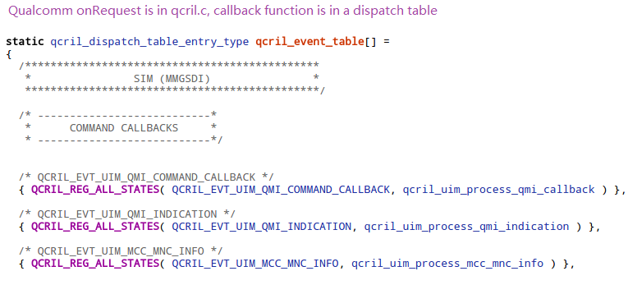
1，different on RILC
2，different on communication with modem
MTK：AT CMD， Qualcomm: SDM
3，Modem design, like below

Slide 4
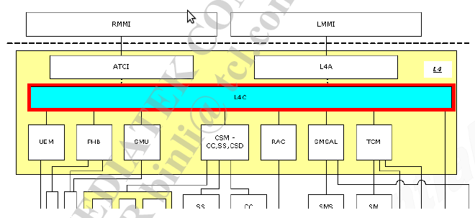
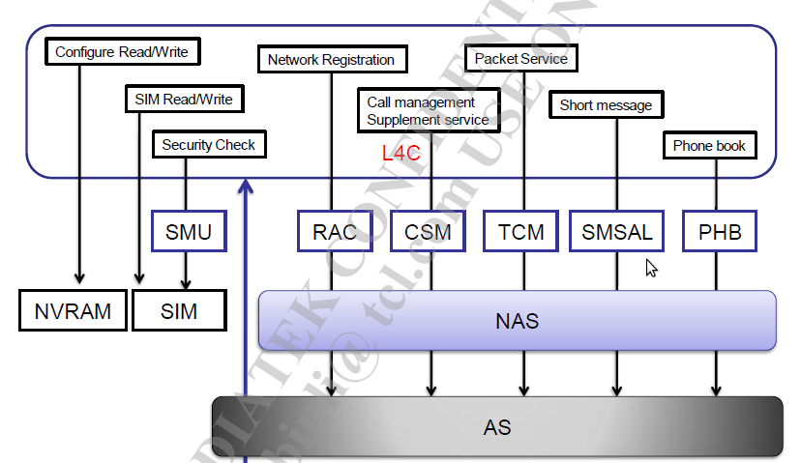
MTK Modem design

Slide 5
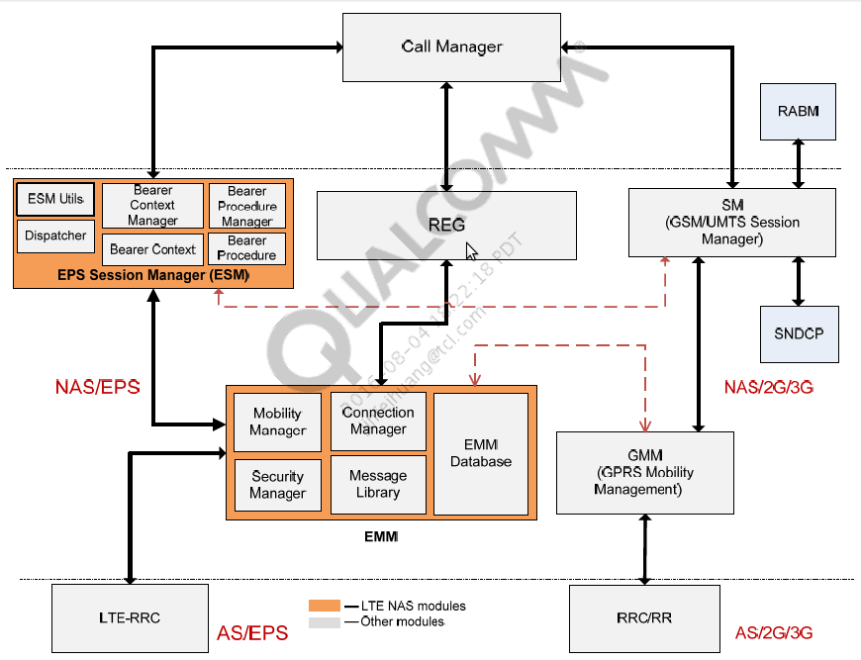
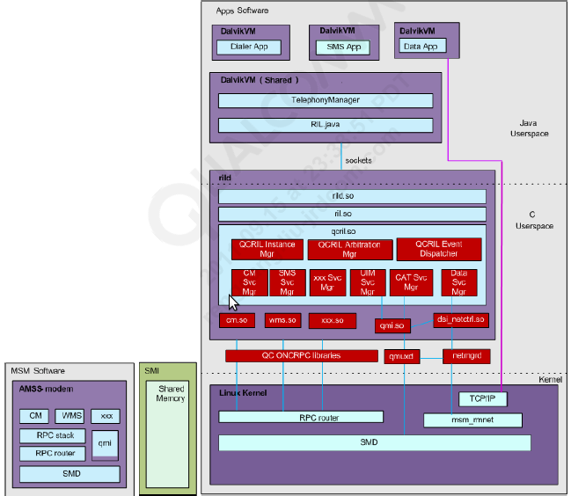
QUALCOMM Modem design

Slide 6
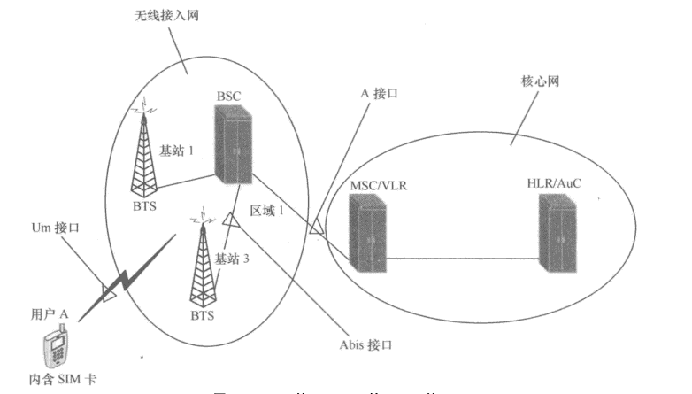
GSM network Architecture

Slide 7
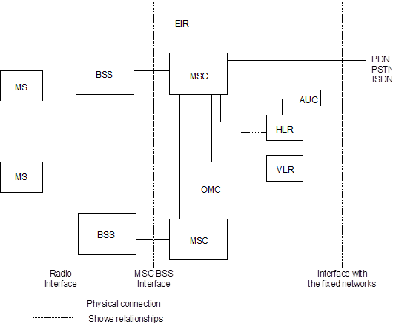
GSM network Architecture
MS:Mobile Station VLR:Visited Location Register
BSS:Base Station System OMC:Operation and Maintenance Centre
MSC:Mobile services Switching Centre EIR:Equipment Identity Register
HLR:Home Location Register AUC:Authentication Centre

Slide 8
GSM network Architecture
BSS: Base Station System:
is the physical equipment used to give radio coverage to a determined geographical zone called a cell, and to contain the equipment needed to communicate with MS
MSC: Mobile services Switching Centre
is a switching centre that holds all the switching functions needed for mobiles located in an associated geographical area, called an MSC area
HLR: Home Location Register
Two types of basic information are stored in the HLR:
Subscriber information
part of the mobile location information
VLR: Visited Location Register
is the functional unit that dynamically stores subscriber information, such as location area, when the subscriber is located in the area this VLR is in charge of.
- Mobile Station Roaming Number.
-Temporary Mobile Subscriber Identity, if applicable
-The location area in which the mobile has been registered.
-Data related to supplementary service parameters

Slide 9
GSM network Architecture
Signal plan

Slide 10
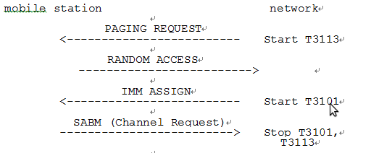
RR: Radio Resource management
A, Idle mode procedures
MS listens to the BCCH for SI
MS listens to the paging sub-channel
B, RR connection establishment
immediate assignment procedure
Mobile Station Network
CHANNEL REQUEST ------------------------->
IMMEDIATE ASSIGNMENT <------------------------
C, Paging procedure

Slide 11
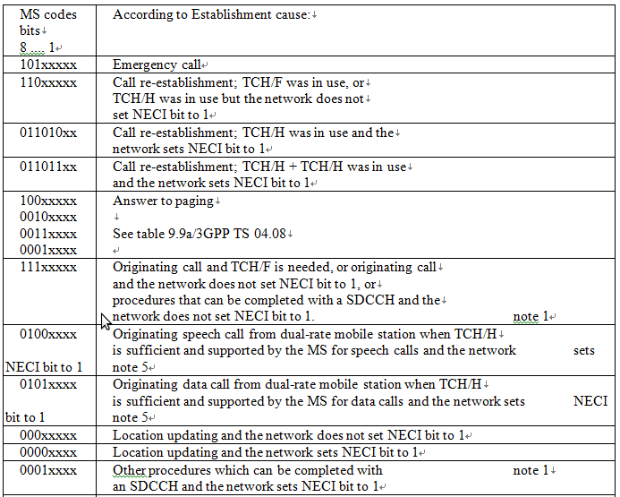
Channel Request message contact

Slide 12
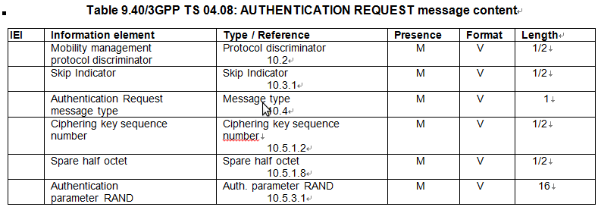
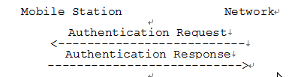
MM: Mobility Management
(i) MM common procedures:
-TMSI reallocation procedure;
-authentication procedure;
-identification procedure;
-MM information procedure;
-IMSI detach procedure
(ii) MM specific procedures:
-normal location updating procedure;
-periodic updating procedure;
-IMSI attach procedure.
(iii) MM connection management procedures:

Slide 13
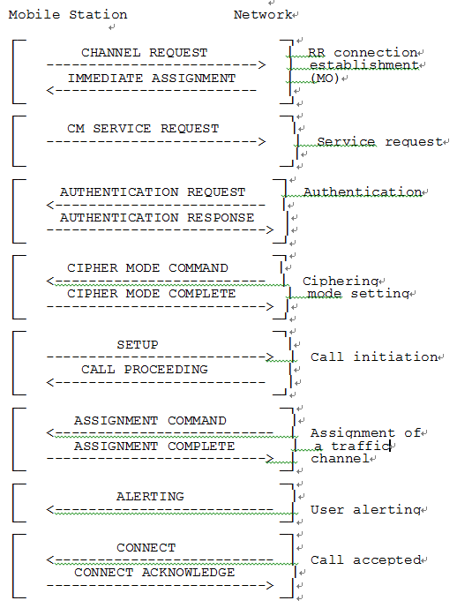
CC: circuit-switched Call Control
- call establishment procedures;
- call clearing procedures;
- call information phase procedures;
- miscellaneous procedures.

Slide 14
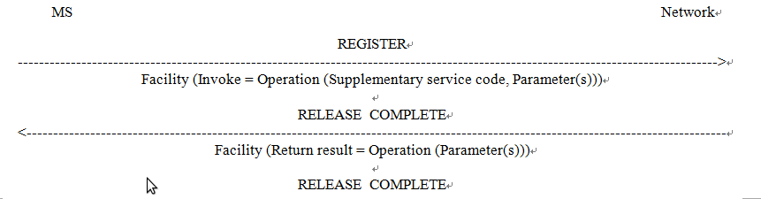
SS:Supplementary services
Call related supplementary service:
CW,CFU,CB….
*#43# ===>interrogation Status of Call Waiting.
*#21# ===>interrogation Status of Call forward
USSD: Unstructured Supplementary Services Data
Like *123#

Slide 15
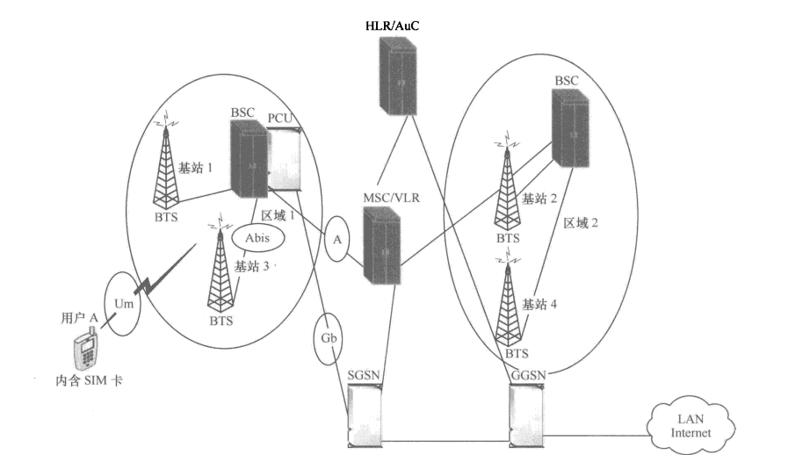
GPRS/EDGE network Architecture

Slide 16
GPRS/EDGE network Architecture

Slide 17
GPRS/EDGE network Architecture
Serving GPRS Support Node (SGSN):
is the node that is serving the MS. At GPRS attach, the SGSN establishes a mobility management context containing information pertaining to e.g., mobility and security for the MS. At PDP Context Activation, the SGSN establishes a PDP context, to be used for routeing purposes, with the GGSN that the GPRS subscriber will be using
Gateway GPRS Support Node (GGSN):
is the node that is accessed by the packet data network due to evaluation of the PDP address.
It contains routeing information for attached GPRS users. The routeing information is used to tunnel N‑PDUs to the MS's current point of attachment., i.e., the Serving GPRS Support Node. The GGSN may request location information from the HLR via the optional Gc interface. The GGSN is the first point of PDN interconnection with a GSM PLMN supporting GPRS

Slide 18
GPRS/EDGE network Architecture
Signal plan

Slide 19
GPRS/EDGE network Architecture
Transmission plane

Slide 20
MAC: Medium Access Control
Paging procedures
Medium Access Control (MAC) procedures on PCCCH
TBF establishment initiated by the mobile station on PCCCH
TBF establishment initiated by the network on PCCCH
Procedure for measurement report sending in packet idle mode
Cell Change Order procedures in Packet Idle mode
Medium Access Control (MAC) Procedures in Packet Transfer Mode
Transfer of RLC data blocks
Packet PDCH Release
Procedure for measurement report sending in Packet Transfer mode
Network controlled cell reselection procedure

Slide 21
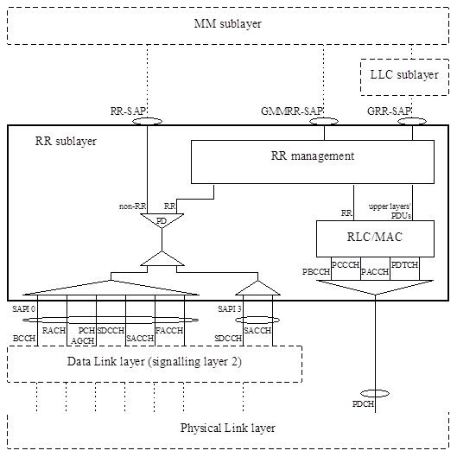
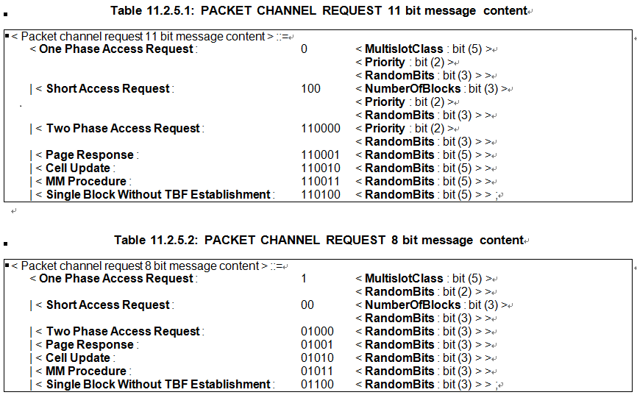
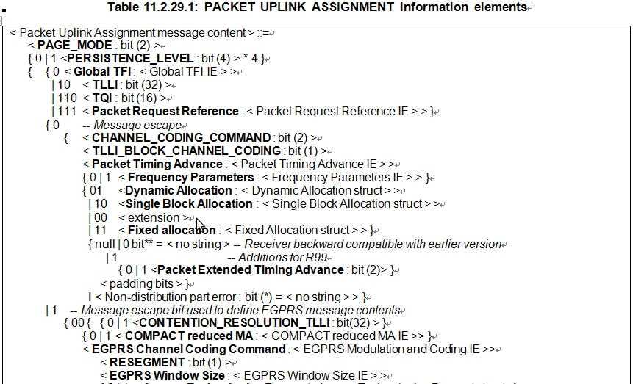
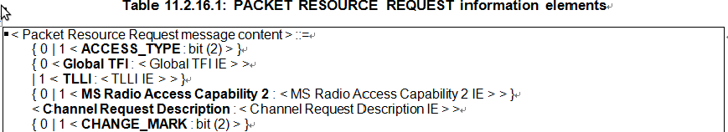
MAC: Medium Access Control

Slide 22
RLC: Radio Link Control
RLC function is responsible for:
- Interface primitives allowing the transfer of Logical Link Control layer PDUs (LLC PDU) between the LLC layer and the MAC function.
- Segmentation of LLC PDUs into RLC data blocks and re-assembly of RLC data blocks into LLC PDU.
- Segmentation of RLC/MAC control messages into RLC/MAC control blocks and re-assembly of RLC/MAC control messages from RLC/MAC control blocks.
- Backward Error Correction (BEC) procedures enabling the selective retransmission of RLC data blocks.

Slide 23
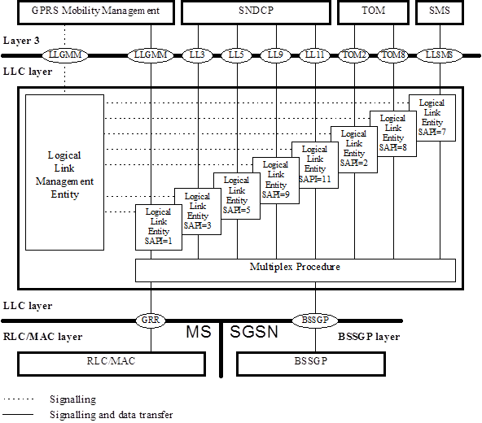
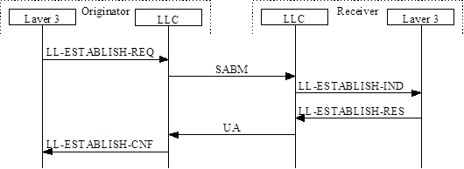
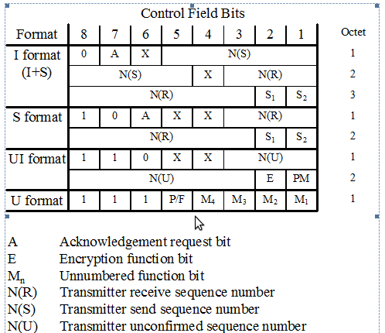
LLC: Radio Link Control
LLC layer can be summarised as follows:
- LLC shall provide a highly reliable logical link between the MS and the SGSN.
- variable-length information frames.
- peer-to-peer data transfers.
- acknowledged and unacknowledged data transfers.
- user data confidentiality by means of a ciphering function.

Slide 24
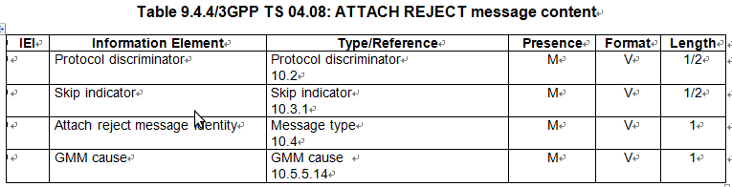
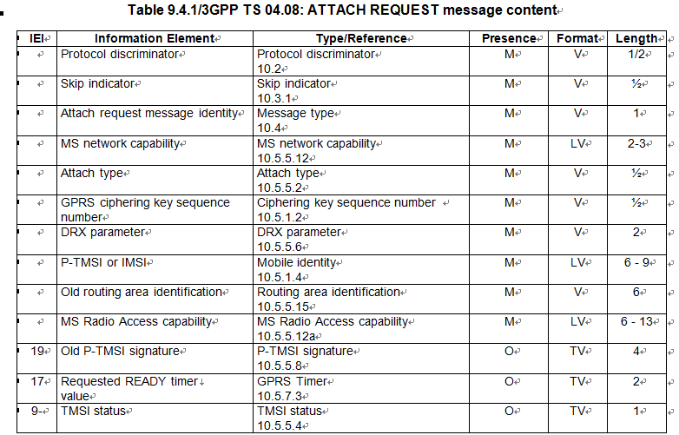
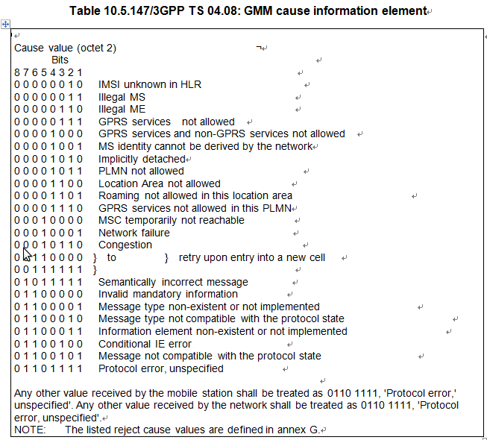
GMM: GPRS mobility management
- ATTACH REQUEST;
- ATTACH REJECT;
- AUTHENTICATION AND CIPHERING REQUEST;
- AUTHENTICATION AND CIPHERING RESPONSE;
- AUTHENTICATION AND CIPHERING REJECT;
- IDENTITY REQUEST;
- IDENTITY RESPONSE;
- ROUTING AREA UPDATE REQUEST; and
- ROUTING AREA UPDATE REJECT

Slide 25
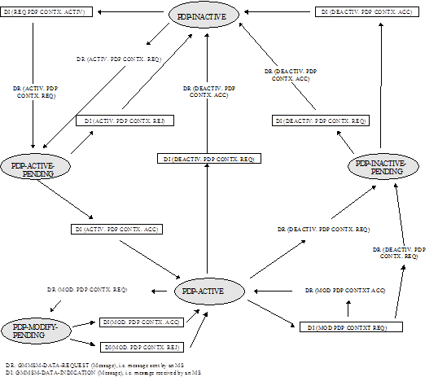
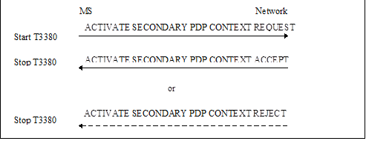
SM: GPRS Session Management
Session Management procedures:
- PDP context activation
- Secondary PDP Context Activation Procedure
- PDP context modification procedure
- PDP context deactivation procedure

Slide 26
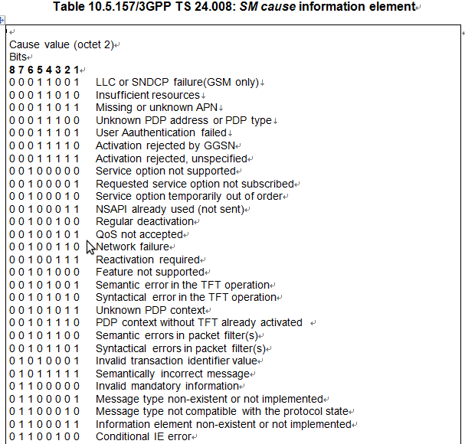
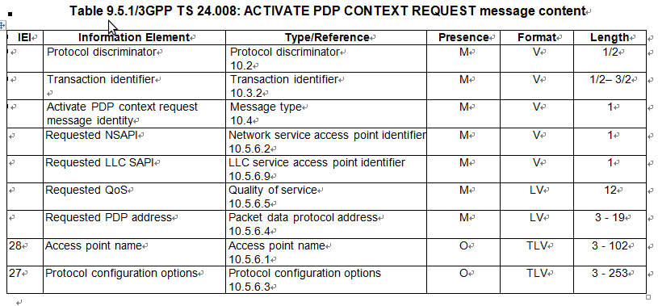
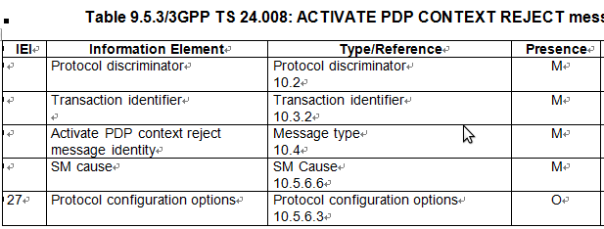
SM: GPRS Session Management
- PDP context activation

Slide 27
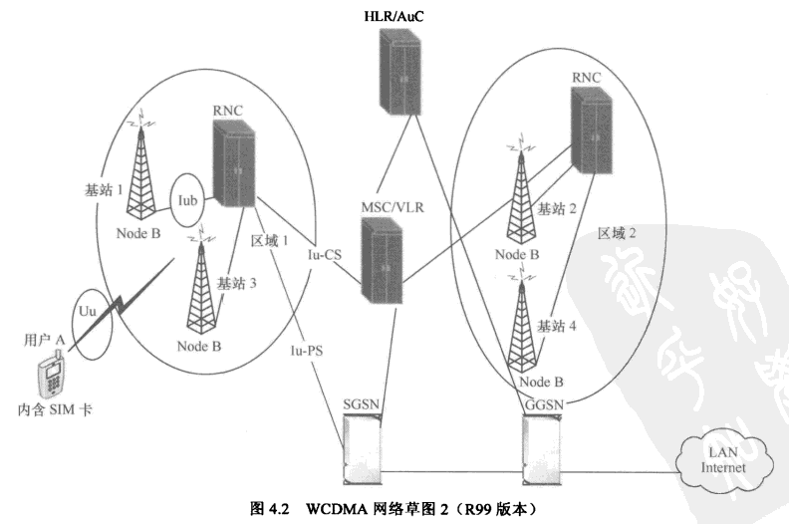
UMTS network Architecture

Slide 28
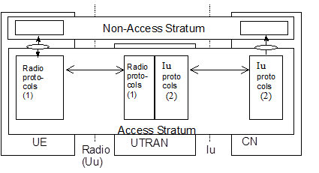
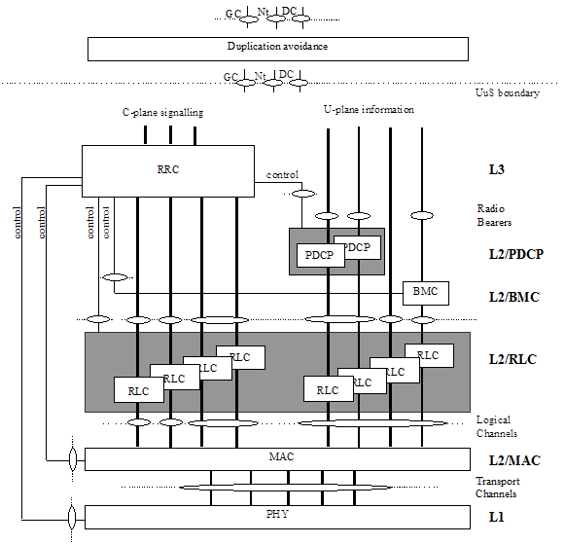
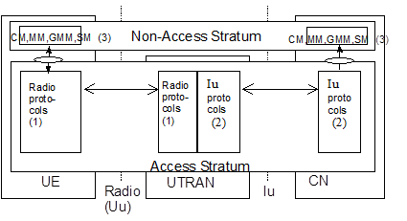
UMTS network Architecture
User plane:
Control plane:

Slide 29
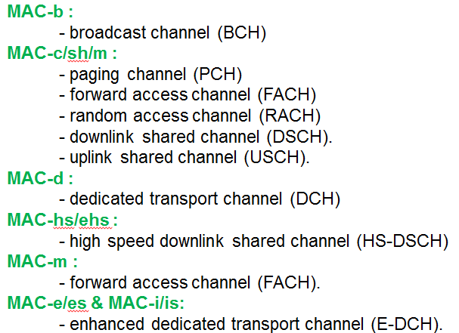
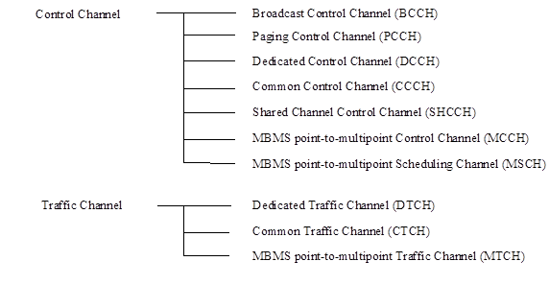
MAC: Medium Access Control
MAC Services to upper layers:
Data transfer
Reallocation of radio resources and MAC parameters
Reporting of measurements

Slide 30
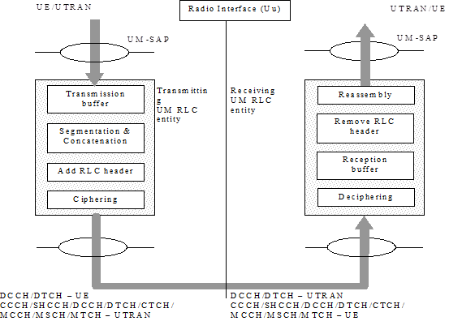
RLC: Radio Link Control
RLC Services provided to the upper layer:
Transparent data transfer
Unacknowledged data transfer
Acknowledged data transfer
Maintenance of QoS as defined by upper layers
Notification of unrecoverable errors
Segmentation and reassembly
Error correction
Flow control
Ciphering
…

Slide 31
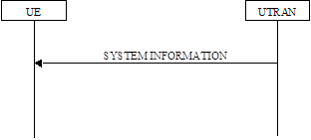
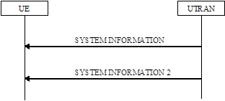
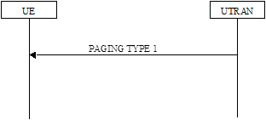
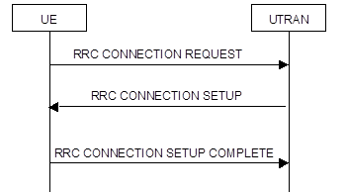
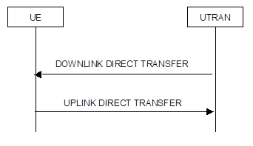
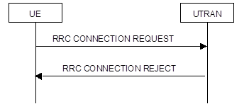
RRC: Radio Resource Control
Services provided to the upper layer:
- Broadcast of information provided by the non-access stratum (Core Network)
- Broadcast of information related to the access stratum
Establishment , re-establishment, maintenance and release of an RRC connection
between the UE and UTRAN
- Establishment, reconfiguration and release of Radio Bearers
- Assignment, reconfiguration and release of radio resources for the RRC connection
RRC connection mobility functions.
Paging/notification
UE measurement reporting and control of the reporting

Slide 32
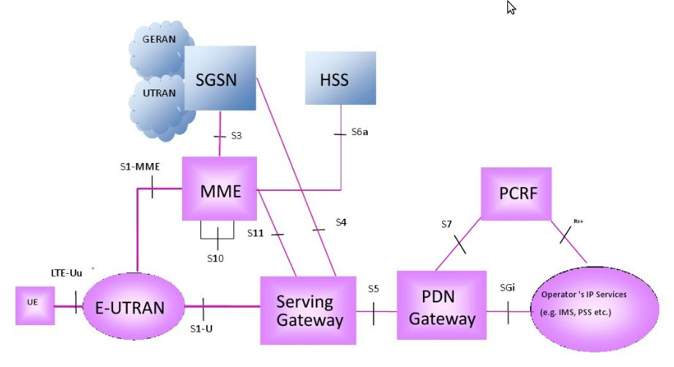
LTE network Architecture

Slide 33
EPS:Evolved Packet System
Main functions of the protocols that are part of the NAS are:
- the support of mobility of the user equipment (UE);
the support of session management procedures to establish and maintain IP connectivity between the UE and a packet data network gateway (PDN GW).
SO→
elementary procedures for EPS mobility management
- elementary procedures for EPS session management
EMM procedures:
1),EMM common procedures:
- GUTI reallocation;
- authentication;
- security mode control;
- identification;
- EMM information
2),EMM specific procedures:
- attach and combined attach
- detach and combined detach.
- normal tracking area updating and combined tracking area updating
- periodic tracking area updating
3), EMM connection management procedures

Slide 34
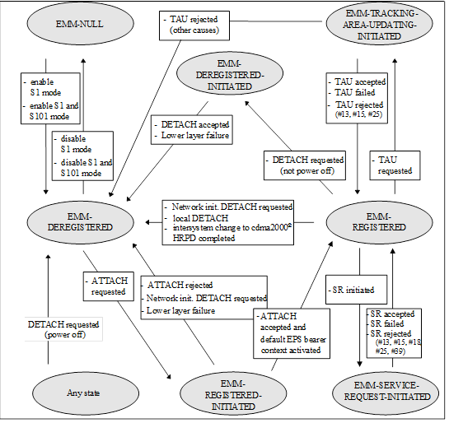
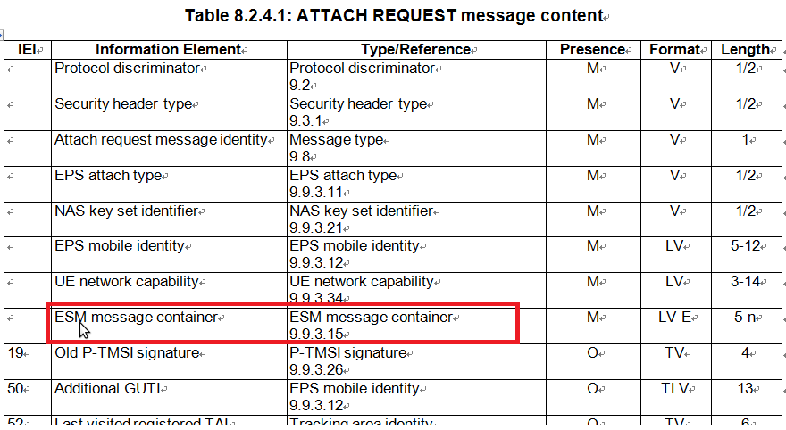
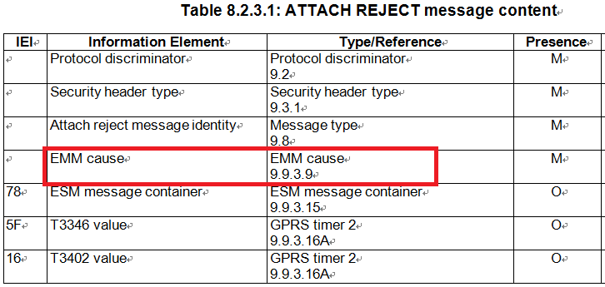
EPS:Evolved Packet System
3), EMM connection management procedures
- service request.
- paging procedure.
- transport of NAS messages;
- generic transport of NAS messages.

Slide 35
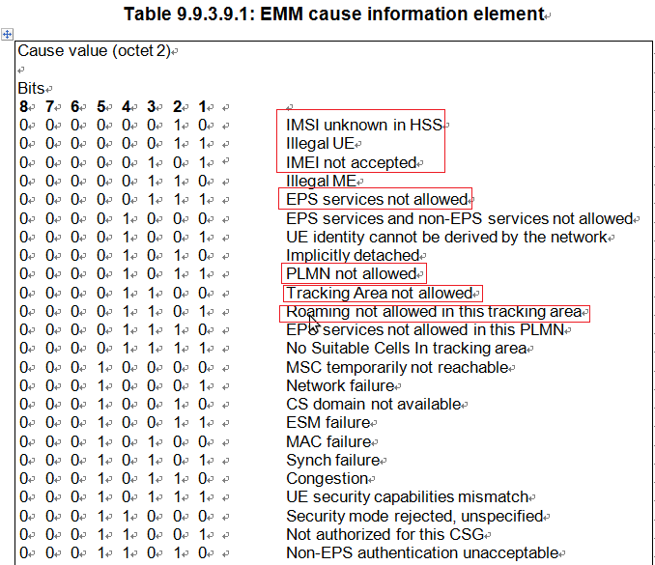
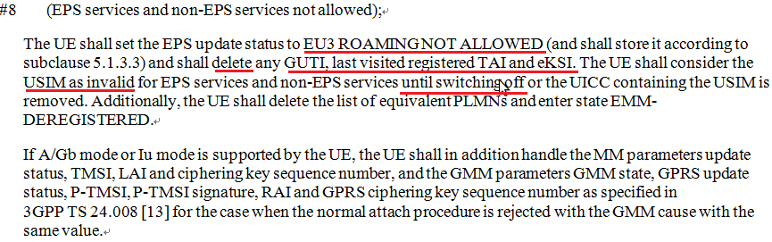
EPS:Evolved Packet System
EMM Cause

Slide 36
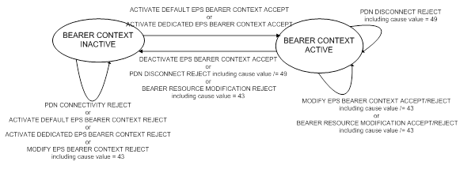
EPS:Evolved Packet System
EPS session management
Procedures related to EPS bearer contexts:
- default EPS bearer context activation;
- dedicated EPS bearer context activation;
- EPS bearer context modification;
- EPS bearer context deactivation.
2) Transaction related procedures:
- PDN connectivity procedure;
- PDN disconnect procedure;
- bearer resource allocation procedure;
bearer resource modification procedure.
ESM sublayer states

Slide 37




EPS:Evolved Packet System
UE requested PDN connectivity procedure:
UE requested PDN disconnect procedure:

Slide 38




EPS:Evolved Packet System
Default EPS bearer context activation initiated by the network:
Dedicated EPS bearer context activation procedure:

Slide 39

EPS:Evolved Packet System
ESM Cause

Slide 40


SIM/USIM Protocol
SIM: Subscriber Identity Module
ATR: Answer To Reset

Slide 41

SIM/USIM Protocol
SIM: Subscriber Identity Module
ATR: Answer To Reset

Slide 42





SIM: Command & Response

Slide 43



Contents of the Elementary Files
SIM initialization

Slide 44




EF SIM Service Table

Slide 45


SIM Application Toolkit
TERMINAL PROFILE:
Contents: The list of SIM Application Toolkit facilities that are supported by the ME.
Coding: 1 bit is used to code each facility:
bit = 1: facility supported by ME
bit = 0: facility not supported by ME
Proactive SIM commands and procedures:
DISPLAY TEXT - SEND USSD
- SET UP MENU - SET UP CALL
- GET INKEY - SET UP EVENT LIST
- SEND SHORT MESSAGE - SET UP IDLE MODE TEXT
- SEND SS - REFRESH

Slide 46



Spec location
www.3gpp.org

Slide 47
RILJ & RILC
int main(int argc, char **argv) is the entry of RILD.C daemon progress
rild.cmain()
{dlHandle = dlopen(rilLibPath, RTLD_NOW);
RIL_startEventLoop();
rilInit =(const RIL_RadioFunctions *(*)(const struct RIL_Env *, int, char **)) dlsym(dlHandle, "RIL_Init")
rilUimInit =(const RIL_RadioFunctions *(*)(const struct RIL_Env *, int, char **))dlsym(dlHandle, "RIL_SAP_Init");
funcs = rilInit(&s_rilEnv, argc, rilArgv)RIL_register(funcs);}
ril.cpp
RIL_startEventLoop(void){int result = pthread_create(&s_tid_dispatch, &attr, eventLoop, NULL);}
eventLoop(void *param){ril_event_init();ril_event_loop();}
ril_event.cppril_event_loop(){ for (;;) { firePending();}
RIL_register (const RIL_RadioFunctions *callbacks)
processCommandsCallback(int fd, short flags, void *param)
processCommandBuffer(void *buffer, size_t buflen, RIL_SOCKET_ID socket_id)
{pRI->token = token;
pRI->pCI = &(s_commands[request]);
pRI->socket_id = socket_id;
pRI->pCI->dispatchFunction(p, pRI);}
CommandInfo s_commands[] =
{#include "ril_commands.h"} === > Request ID must the same in RILConstants.java & ril.h
{RIL_REQUEST_CONFERENCE, dispatchVoid, responseVoid};
CALL_ONREQUEST(pRI->pCI->requestNumber, NULL, 0, pRI, pRI->socket_id);
#define CALL_ONREQUEST(a, b, c, d, e) s_callbacks.onRequest((a), (b), (c), (d), (e))

Slide 48
RILJ & RILC
qcril.c
static qcril_dispatch_table_entry_type qcril_event_table[] =
{/*25 - RIL_REQUEST_SEND_SMS */
{ QCRIL_REG_ALL_ACTIVE_STATES( RIL_REQUEST_SEND_SMS, qcril_sms_request_send_sms ) },
/* 26 - RIL_REQUEST_SEND_SMS_EXPECT_MORE */
{ QCRIL_REG_ALL_ACTIVE_STATES( RIL_REQUEST_SEND_SMS_EXPECT_MORE, qcril_sms_request_send_sms_expect_more ) }},
qcril.c
RIL_Init
{qcril_event_init();
qcril_init(c_argc, c_argv);
qmi_ril_initiate_bootup();}
qcril_event.c
qcril_event_init(){ret = pthread_create(&qcril_event.tid, &attr, qcril_event_main, NULL);}
qcril_event_main()
{for (;;){ err_no = qcril_process_event( ev->instance_id, ev->modem_id, ev->event_id, ev->data, ev->datalen, ev->t ); }}
qcril.c
qcril_process_event(){err_no = qcril_execute_event( &params, &is_dedicated_thread );}
qcril_execute_event
{qcril_hash_table_lookup( (uint32) params_ptr->event_id, &entry_ptr );
error = qcril_dispatch_event( entry_ptr, params_ptr );}
qcril_dispatch_event( entry_ptr, params_ptr ){(entry_ptr->handler)(params_ptr, &ret);}

Slide 49


Issue Share
Defect: 2755192 [CTS][WIND] WIND STK response: "MMI Complete“
Steps to Reproduce: 1. Enter WIND STK
2. Manage Services -> WIND Services
3. Attempt to "Check status, Activate or Cancel services."
4. Observe the issue; an error message "MMI Complete" appears.
StkAppService
PhoneUtil
CatService
GsmPhone
RILJ
RILC
SDM
SIM
CM
CNM/MM
RRC
RLC
MAC

Slide 50

Issue Share
Search “/RILJ” in ADB logs: list All the interaction message AP/Modem
D/RILJ ( 3001): [5785]> SEND_USSD ******* [SUB0]
D/RILJ ( 3001): [5785]< SEND_USSD [SUB0]
D/RILJ ( 3001): [UNSL]< UNSOL_ON_USSD 0 [SUB0]
Search “UI ---” in QXDM logs: list All the message from AP to Modem
onRequest: UI --- RIL_REQUEST_SEND_USSD (29) ---> RIL [RID 0, token id 2050, data len 4]
onRequest: UI --- RIL_REQUEST_SEND_USSD (29) ---> RIL [RID 0, token id 2051, data len 4]
onRequest: UI --- RIL_REQUEST_SEND_USSD (29) ---> RIL [RID 0, token id 2053, data len 4]
Search “UI <---” in QXDM logs: list All the message from Modem to APP
RIL[0][event] qcril_send_request_response: UI <--- RIL_REQUEST_SEND_USSD (29) Complete --- RIL RIL[0][event] qcril_send_unsol_response_epilog: UI <--- RIL_UNSOL_ON_USSD (1006) --- RIL RIL[0][event] qcril_send_unsol_response_epilog: UI <--- RIL_UNSOL_ON_USSD (1006) --- RIL

Slide 51
Issue Share
void qcril_qmi_voice_stk_cc_handle_voice_sups_ind(voice_sups_ind_msg_v02* sups_ind_msg)
if ( ( (!is_stk_cc_in_progress && sups_ind_msg->supplementary_service_info.service_type == SERVICE_TYPE_USSD_V02 && qcril_qmi_voice_info.process_sups_ind)
|| (is_stk_cc_in_progress && ( (sups_ind_msg->call_id_valid && sups_ind_msg->call_id == stk_cc_info.call_id_info) || (sups_ind_msg->supplementary_service_info.is_modified_by_call_control))))
&&
sups_ind_msg->data_source_valid && sups_ind_msg->data_source == VOICE_SUPS_DATA_SOURCE_NETWORK_V02)
{
RIL_Errno qcril_qmi_voice_pre_init(void)
{property_get( QCRIL_PROCESS_SUPS_IND, args, "" );}
#define QCRIL_PROCESS_SUPS_IND "persist.radio.process_sups_ind"

Slide 52
1，严谨， 认真，探索
2，不要因为问题而解问题
3，全面考虑，避免更多side-effect

Slide 53
END

